Slide 1
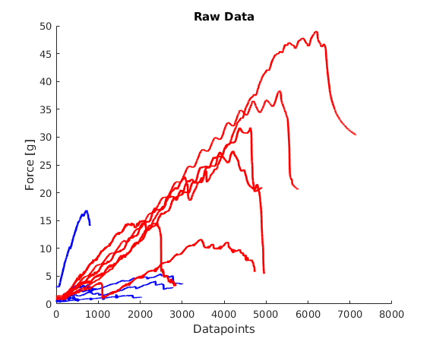
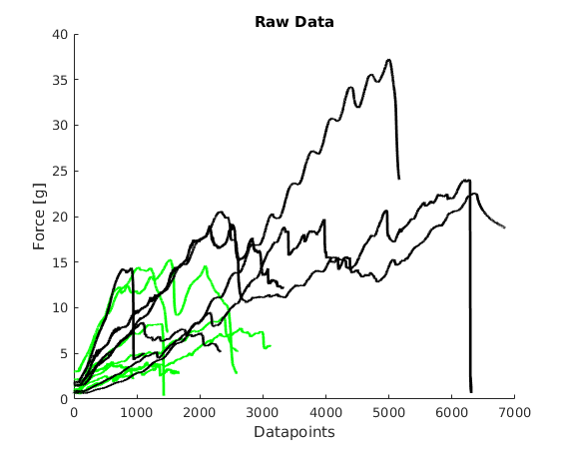
Supplement 1
Supplement 1. Force-displacement curves of healthy and IPF native tissue (left) and scaffolds (right). Datapoints illustrates displacements over time 0.1 mm/s. Measured force in grams (g). Blue line=native healthy tissue. Red line=native IPF tissue. Green line=healthy scaffold. Black line=IPF scaffold.

Slide 2
Supplement 2
Supplement 2. Heat map of all ECM proteins found in healthy and IPF scaffolds (biological replicates n=2, technical replicates n=3). Unsupervised clustering of density adjusted Z-scored intensity values (ward.D2).

Slide 3
Supplement 3
Heavy matrisome
Light matrisome
Supplement 4. Graphs of light and heavy intensity of fibril-associated proteins lumican and perlecan and tissue inhibitor metalloproteinases-3 (TIMP-3). Data shown with calculated grand mean for repopulated scaffold samples (biological replicates per group n=4, with technical replicates n=2). Student t-test for significance between groups with p-values *p<0.05, **p<0.01, ***p<0.001.

Slide 4
Supplement 4
Supplement 3. Basement membrane proteins in the repopulated IPF and healthy scaffolds (biological replicates per group n=4, with technical replicates n=2). Protein intensity shown as light intensity over time for each group. Blue=Healthy, Red= IPF. Perlecan = Basement membrane-specific heparan sulfate proteoglycan core protein.

Slide 5
Supplement 5
Supplement 3. Spearman correlation of light matrisome intensities for all samples. Repopulated scaffolds (IPF and healthy) showed high correlation within the groups over time (1, 3 and 9 days).

